Slide 1


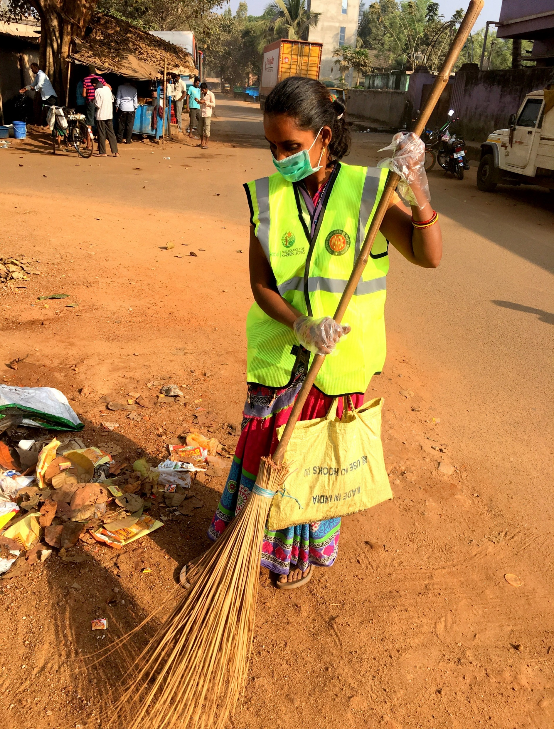
User Manual
SCGJ/Safai Karamchari – App
https://www.scgjsksd.in

Slide 2
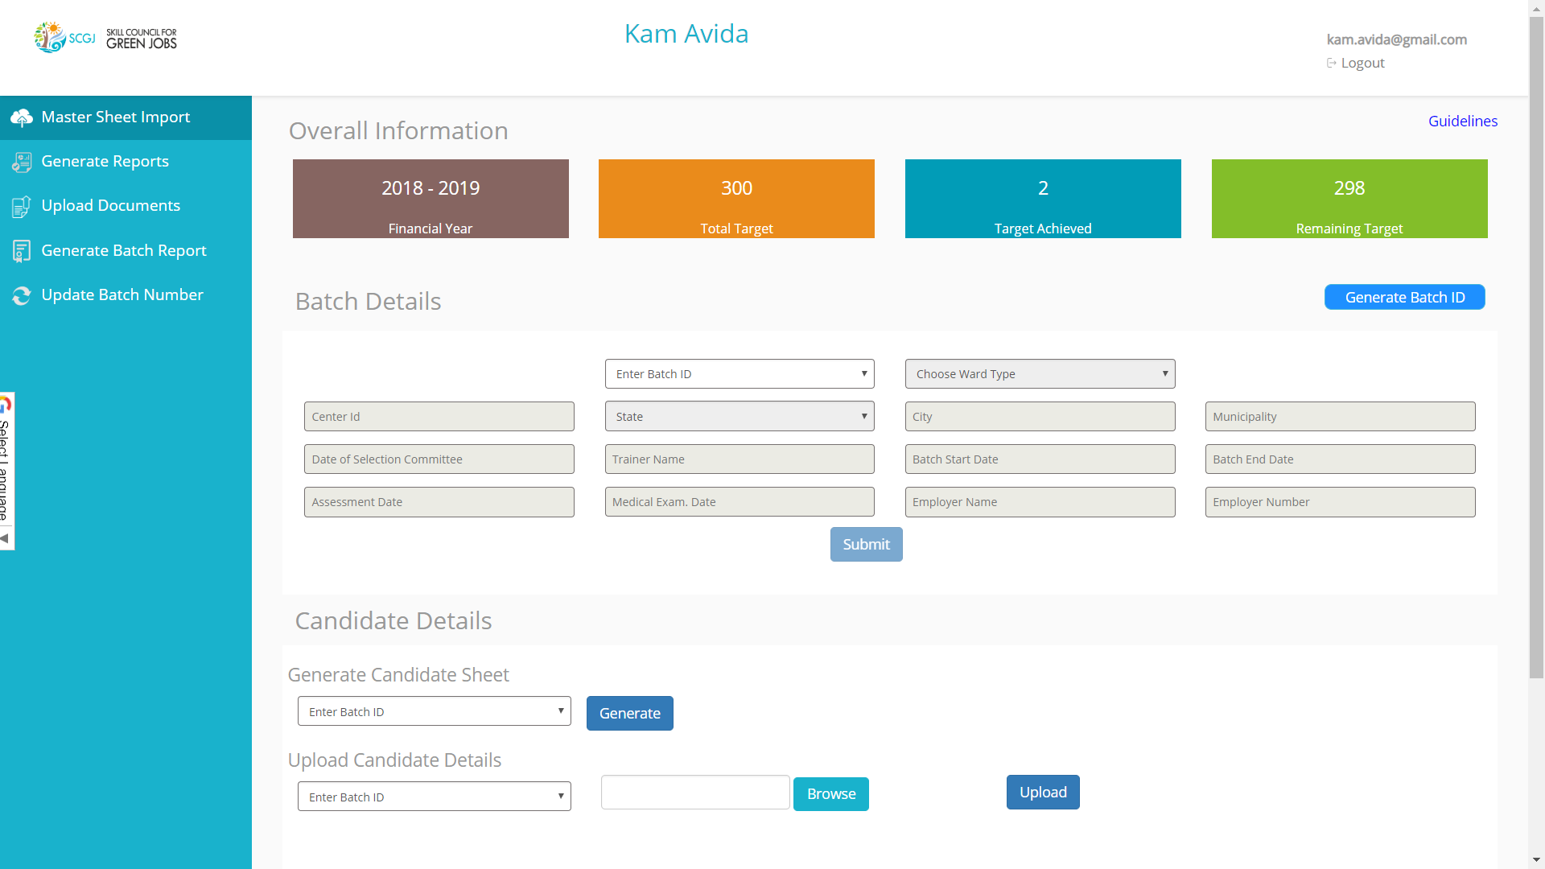
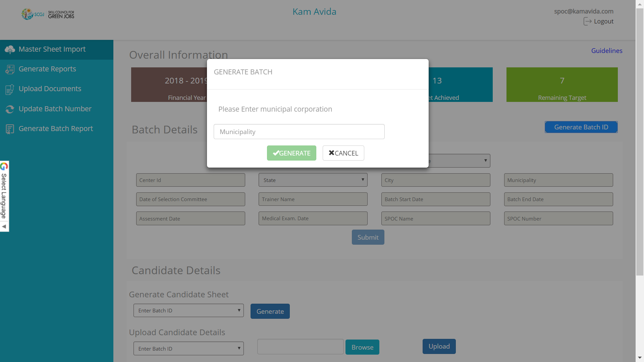
Generate a New Batch
Follow the given steps in-order to generate a new batch :
Click on the Generate Batch Id Button
2. A pop-up box asking for municipality will appear, Add the name of the municipality

Slide 3
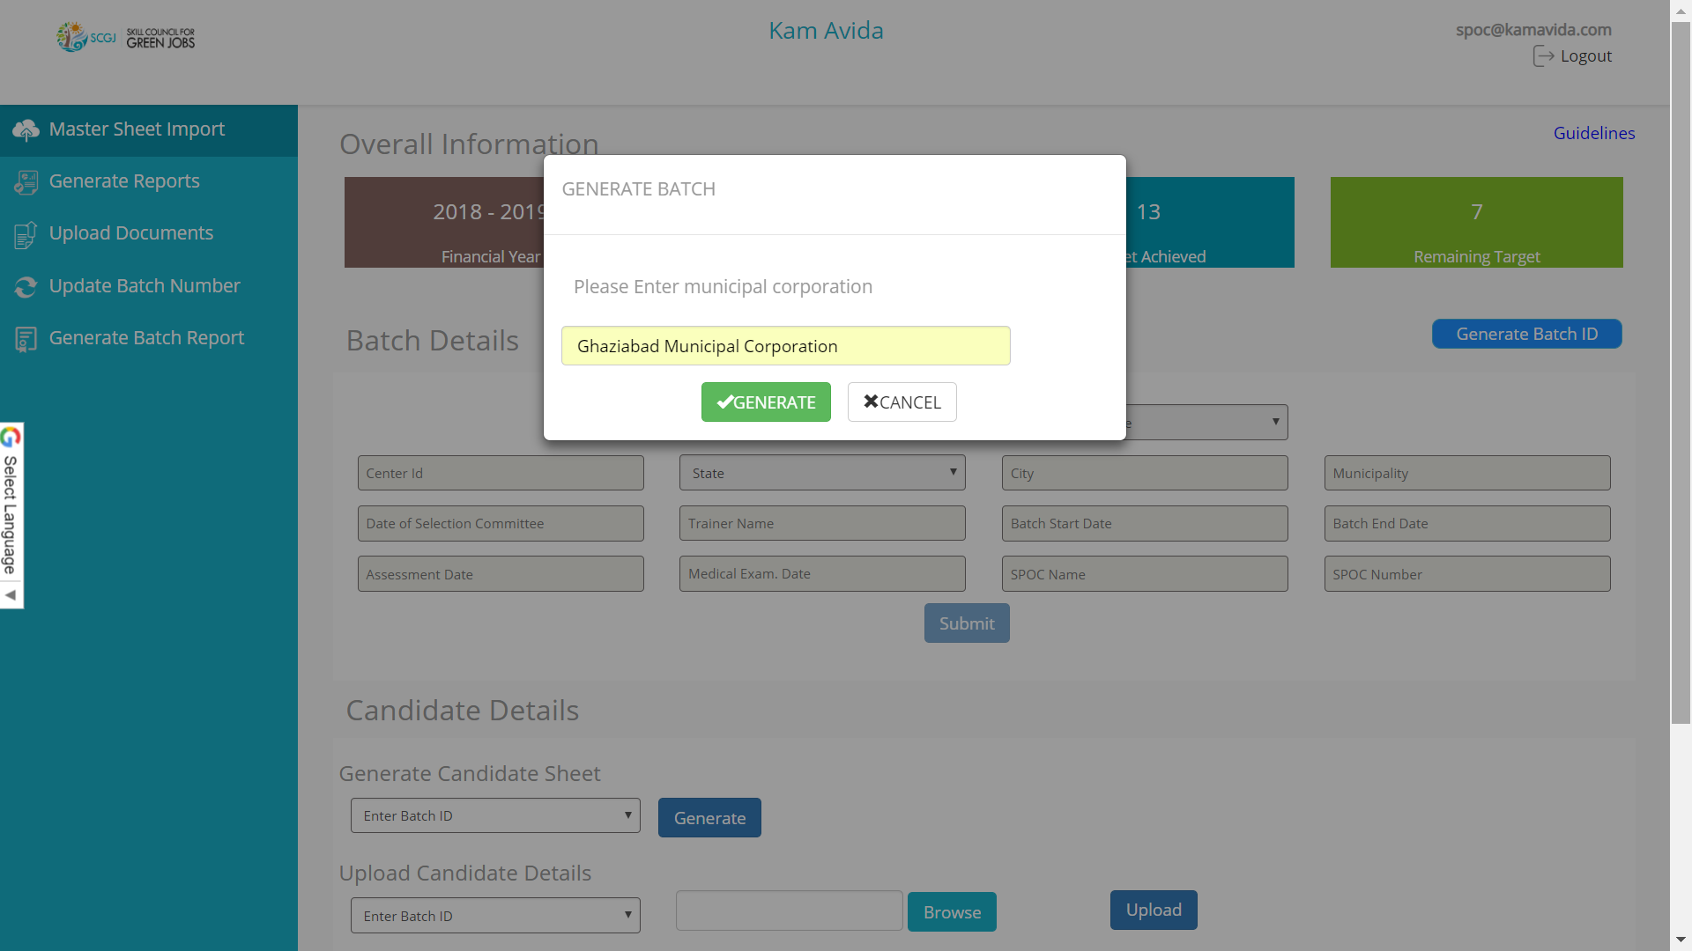
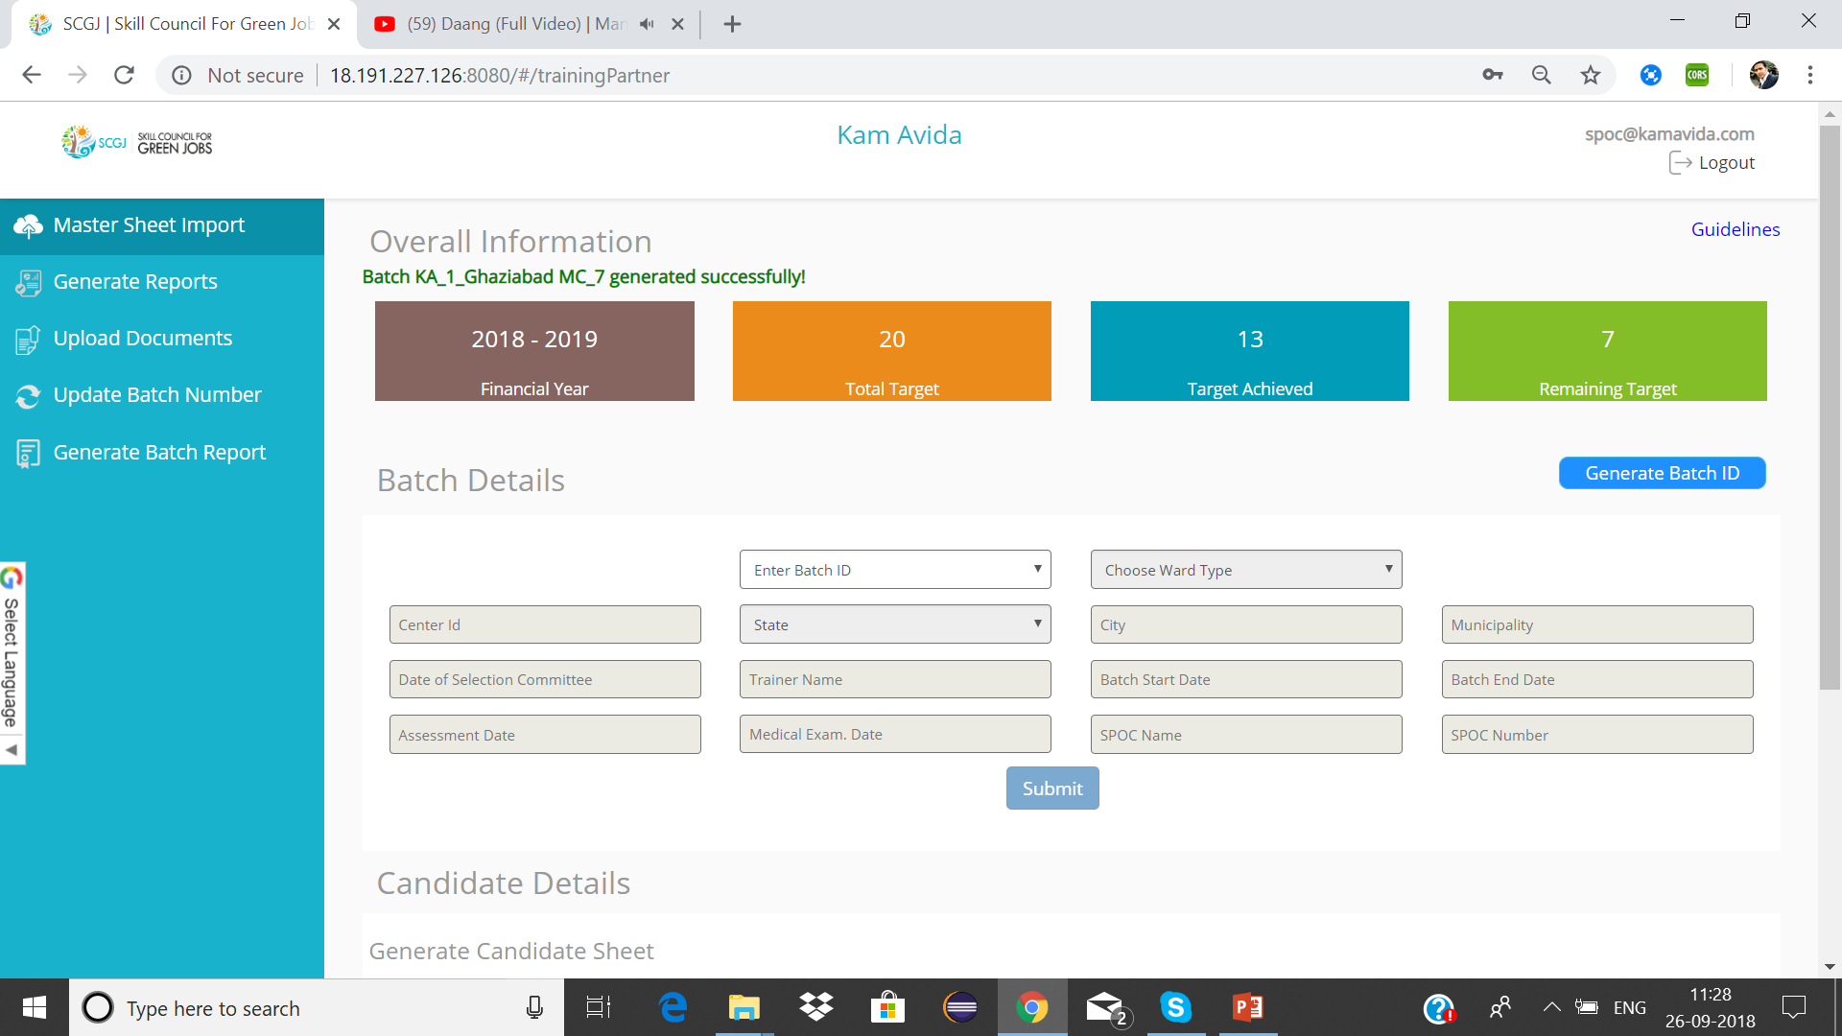
3. Once you have added the municipality name, Click on the Generate button
4. Once you click on the Generate Button, Batch Id will be generated
5. Format of the batch Id generated will be the following
Initials of TP_NSDC Reg. Number _ Name of municipal corporation_ Batch Number
Note: While generating a batch, The user should enter the full name of the municipality

Slide 4

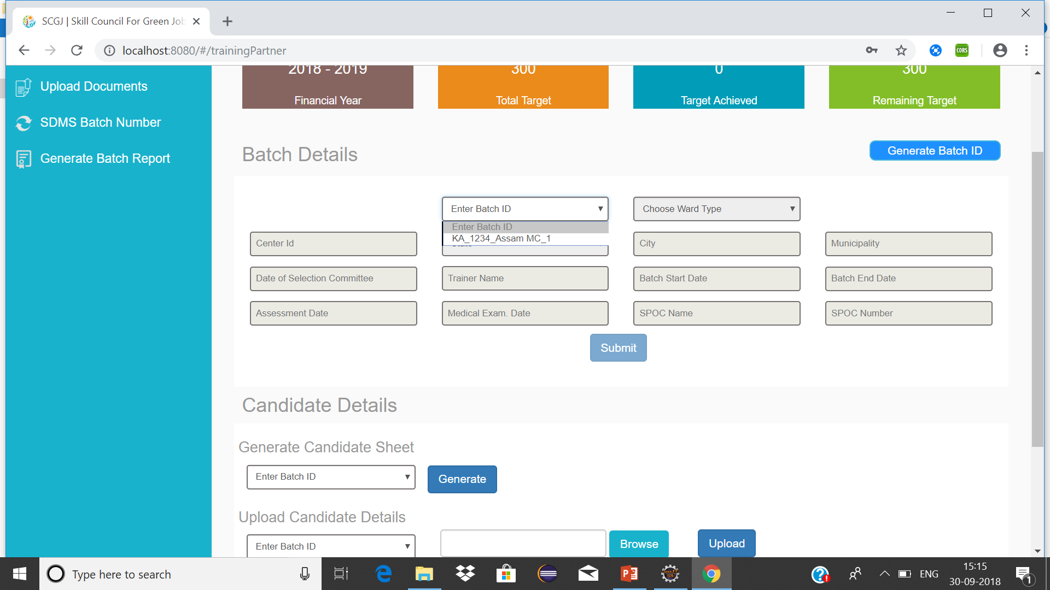

Updating Batch Information
To update the information of a batch, Please follow the given steps :
1. Navigate to batch details section and click on the Enter Batch ID drop down
2. This will show a list of batch id that have been created by the training partner
3. Choose the batch for which information has to be updated

Slide 5
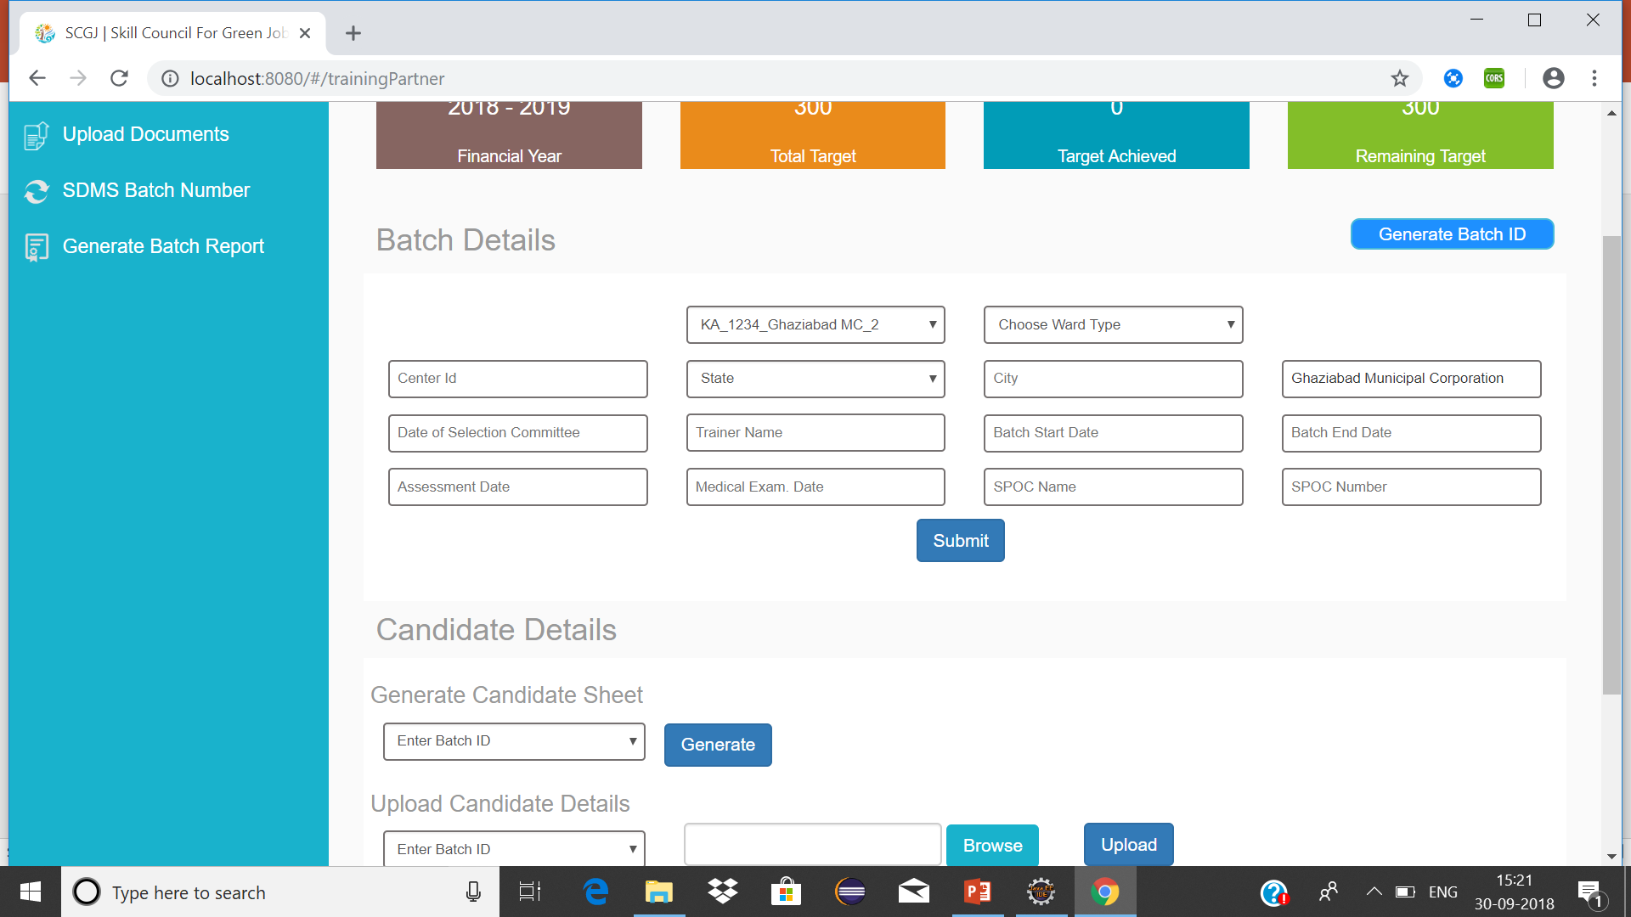
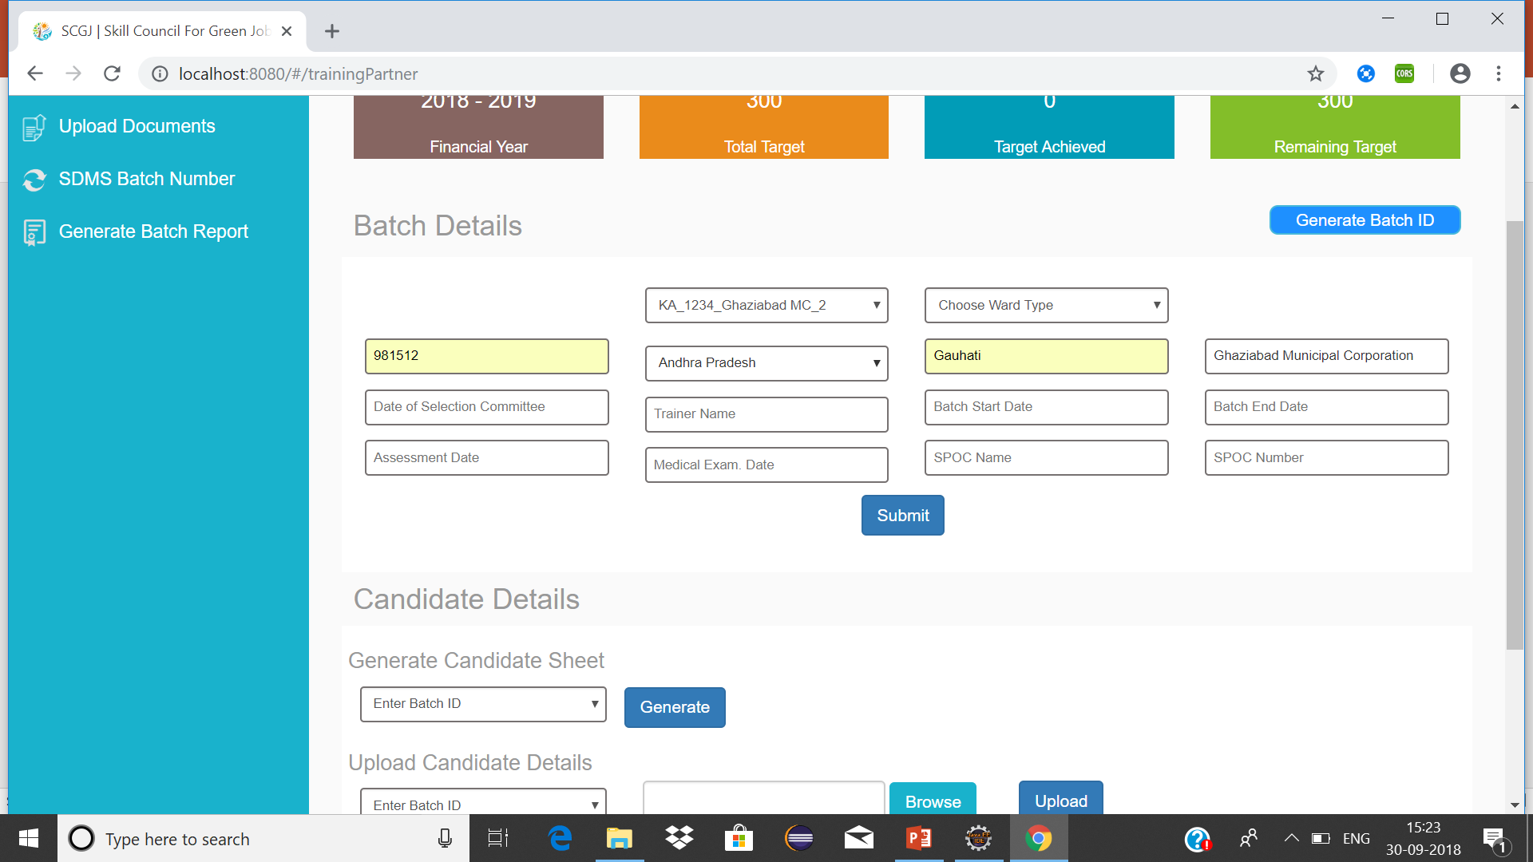

4. Once the Batch ID has been selected, all the fields will be enabled
5. Enter the mandatory fields (Centre ID, State, City, Municipality)
Note: The fields given above are mandatory to fill before any information is inserted in the system. Municipality will contain the name which was filled while generating a batch (User can also update the municipality)
6. Click on Submit button, You will see a success message “Batch Details inserted successfully”
Note: Once these details are inserted, the user can updated the other fields as and when the information is available by selecting the batch id for which the information has to be updated.

Slide 6
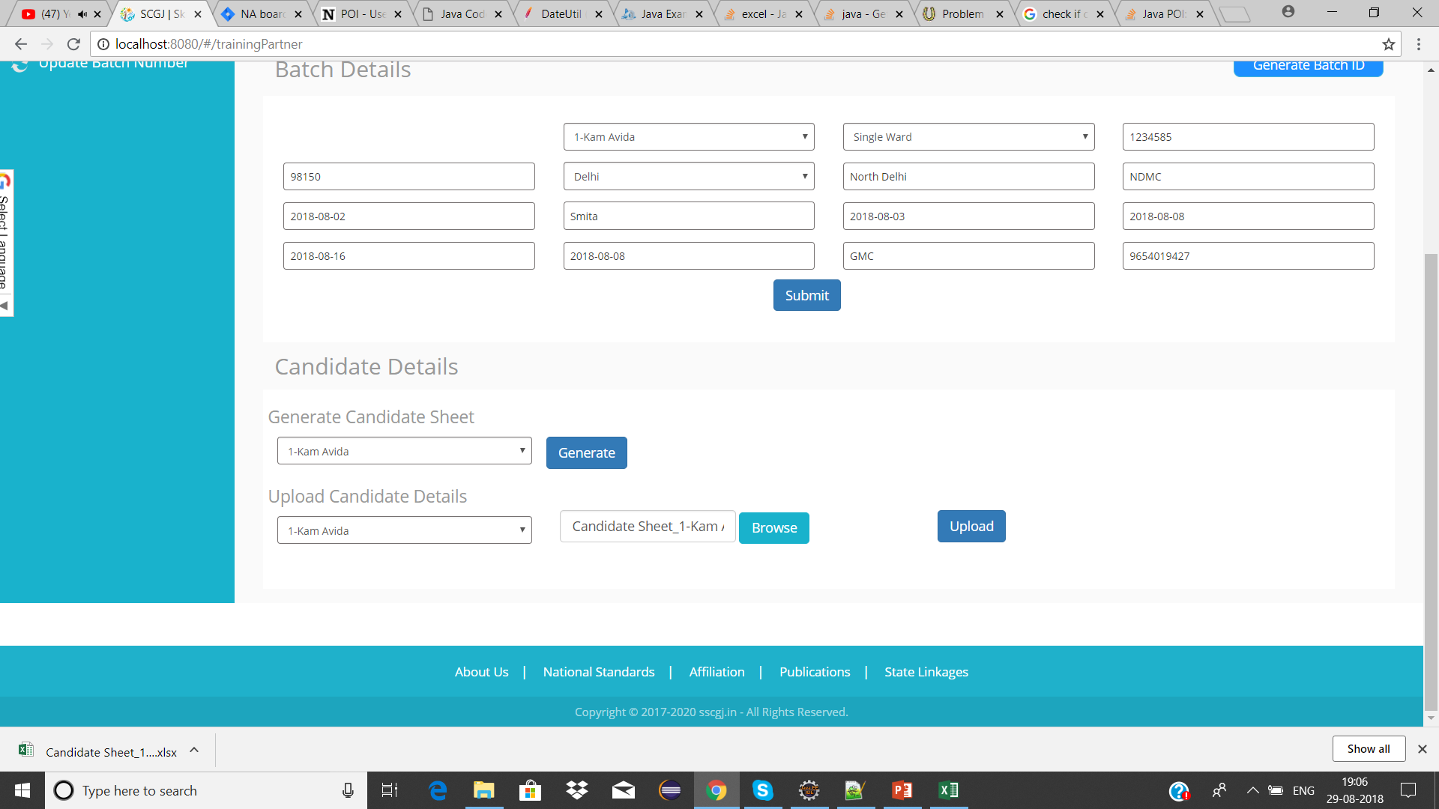
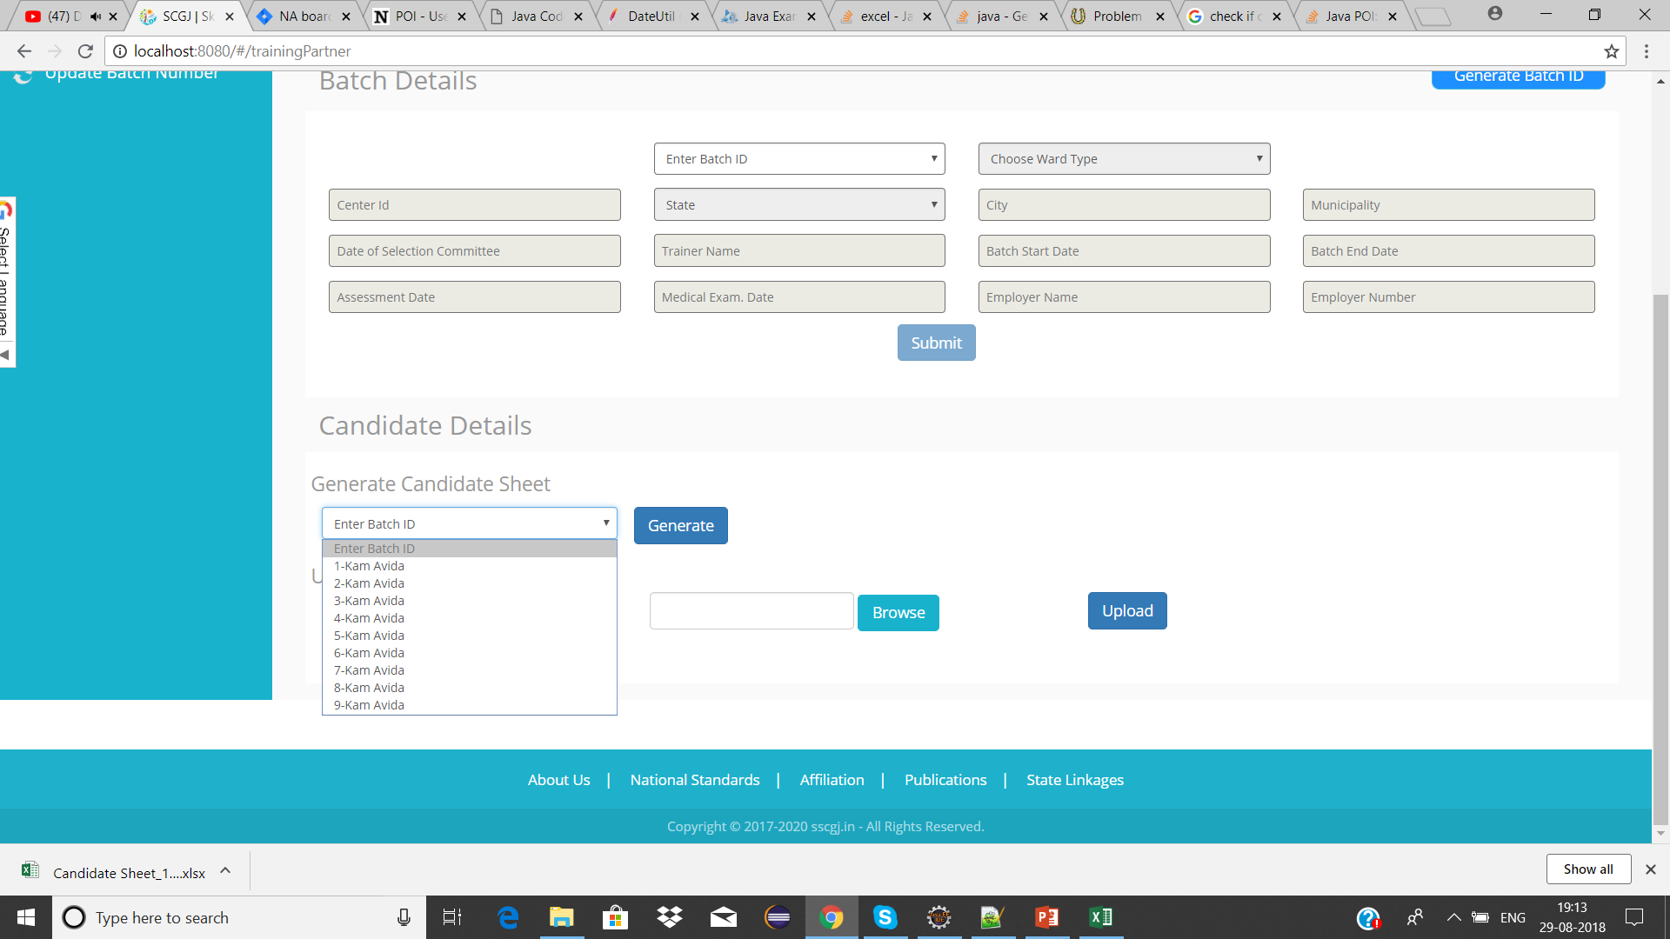
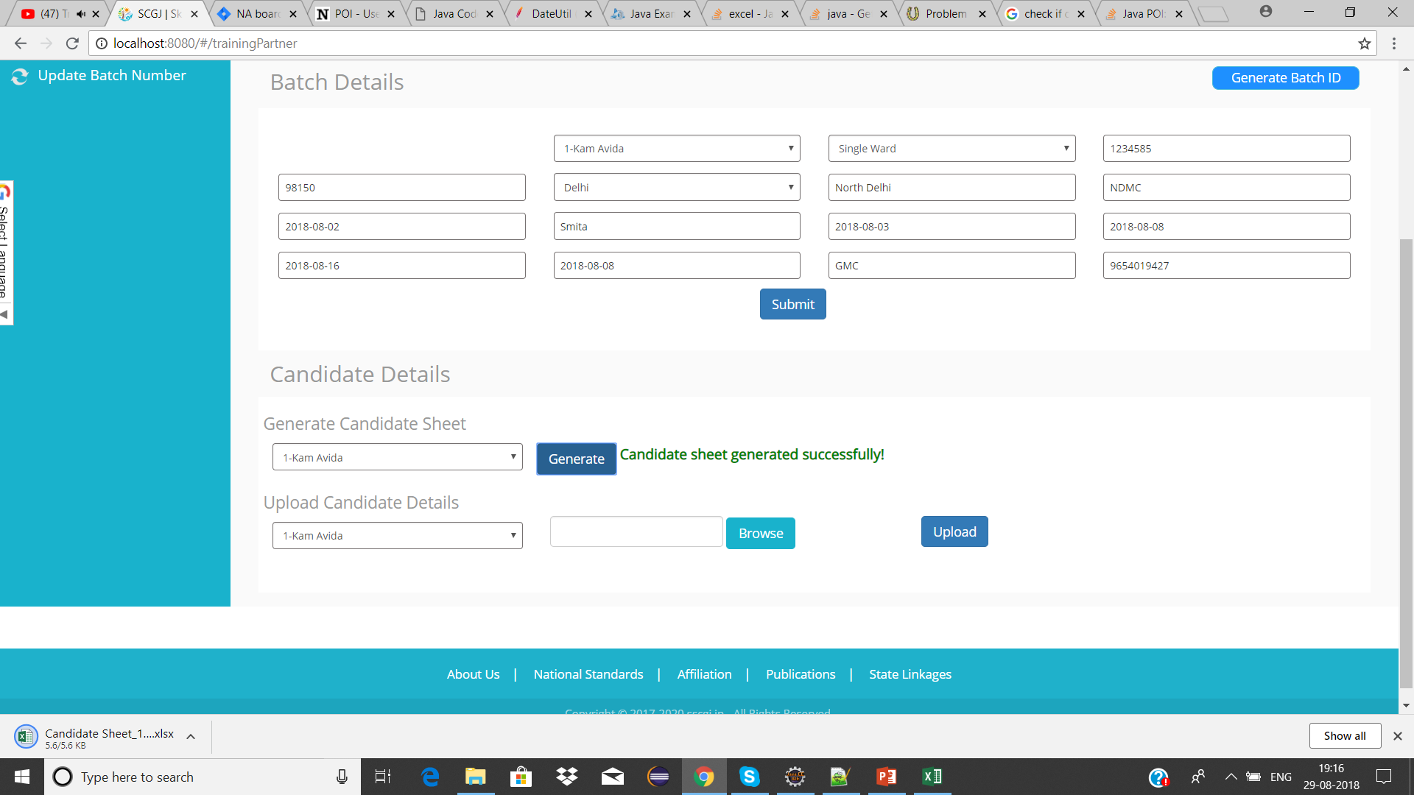
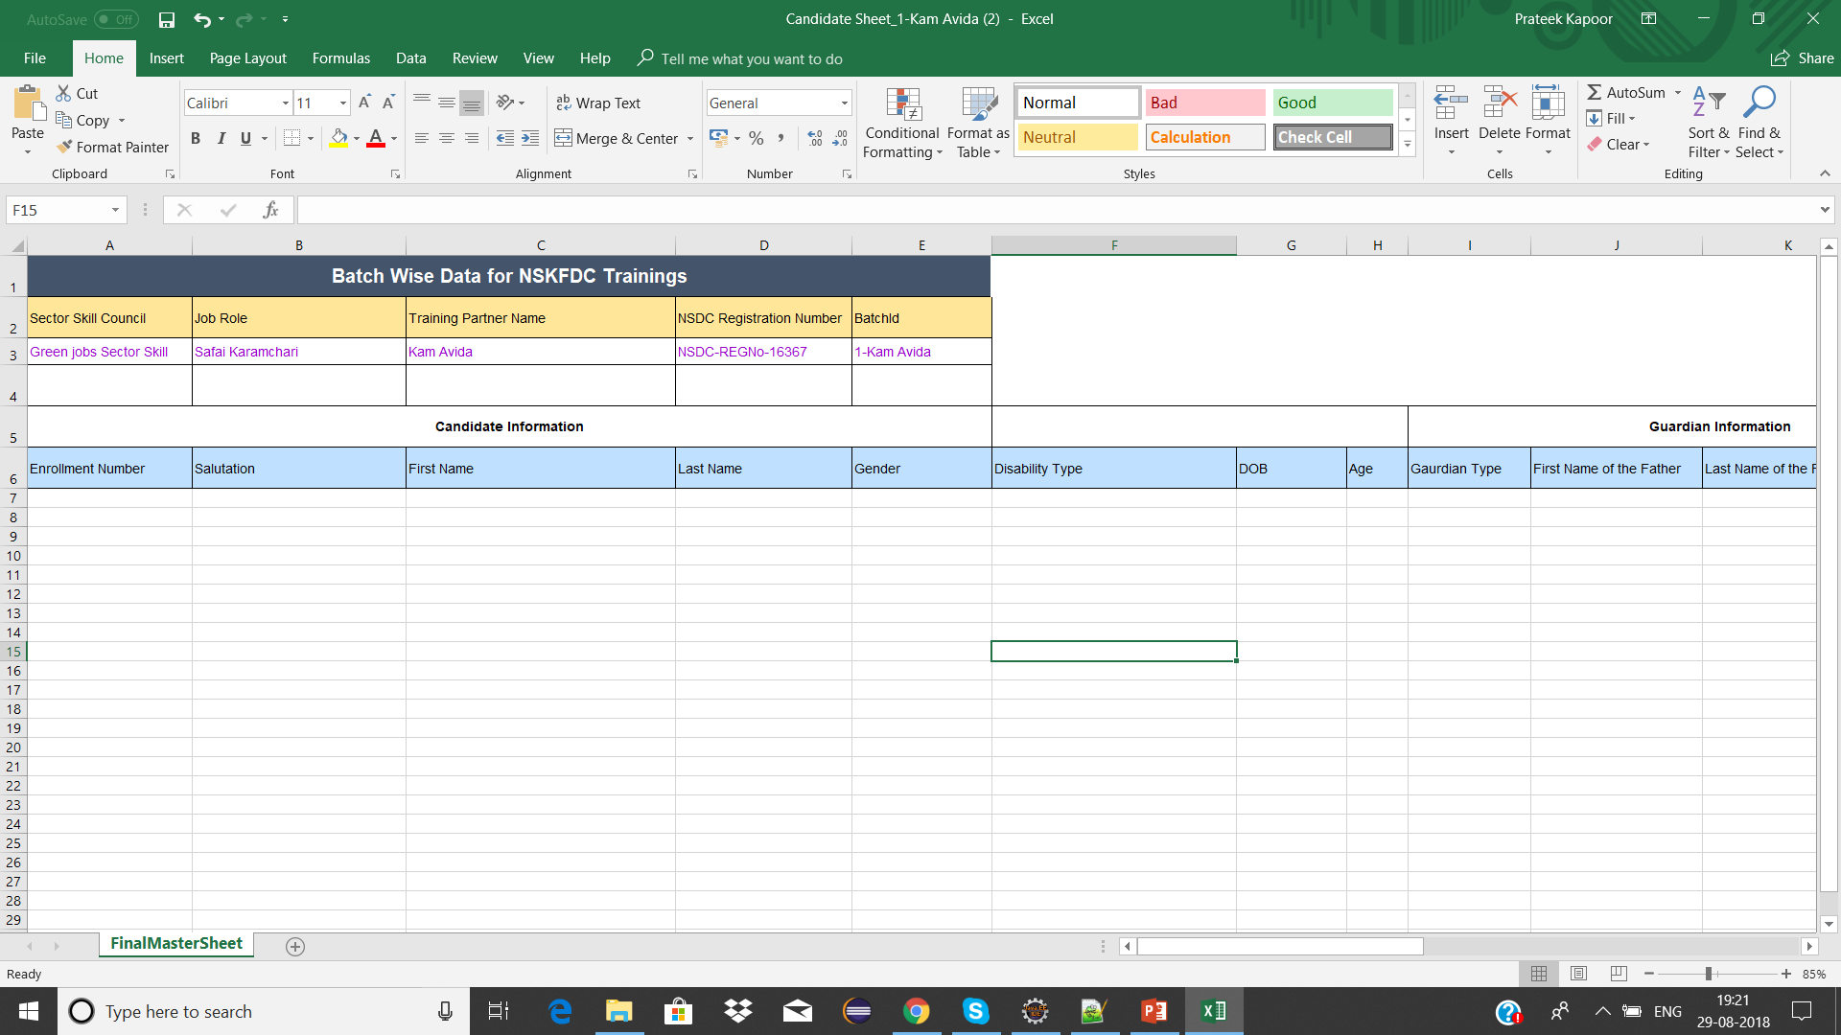
Generating Candidate Sheet
To generate the candidate sheet, perform the following steps :
1. Navigate to the Candidate Details Section
2. Navigate to Generate Credential Sheet to generate the master sheet & select the Batch – ID for which the sheet has to be generated
3. After selecting the batch Id click on Generate button, The file will get downloaded
4. Open the downloaded Excel Sheet, Your sheet will look as shown in the image below

Slide 7
Filling Candidate Sheet
The Candidate Sheet generated by the system has the following columns which the user will edit/update
Candidate Information
Enrolment Number
Salutation
First Name
Last Name
Gender
Disability Type
DOB
Age
Mobile Number
Education Level
State
District
Aadhar Card Number
Id Proof Type(Other than Aadhar Card)
Id Proof No(Other than Aadhar Card)
Occupation / Category
If MS (MS ID)
Relation with SK/MS
Bank Name
IFSC Code
Bank A/C No
Residential Address
Workplace Address
Medical Exam Conducted (Yes/No)
Assessment Result
Employment Type
Guardian’s Information
Guardian Type
First Name of the Father
Last Name of the Father
Mother Name

Slide 8
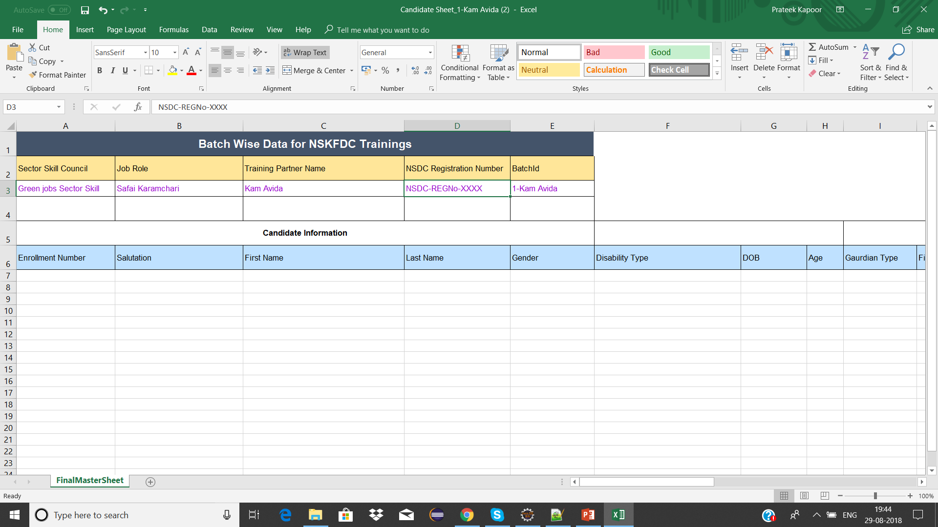
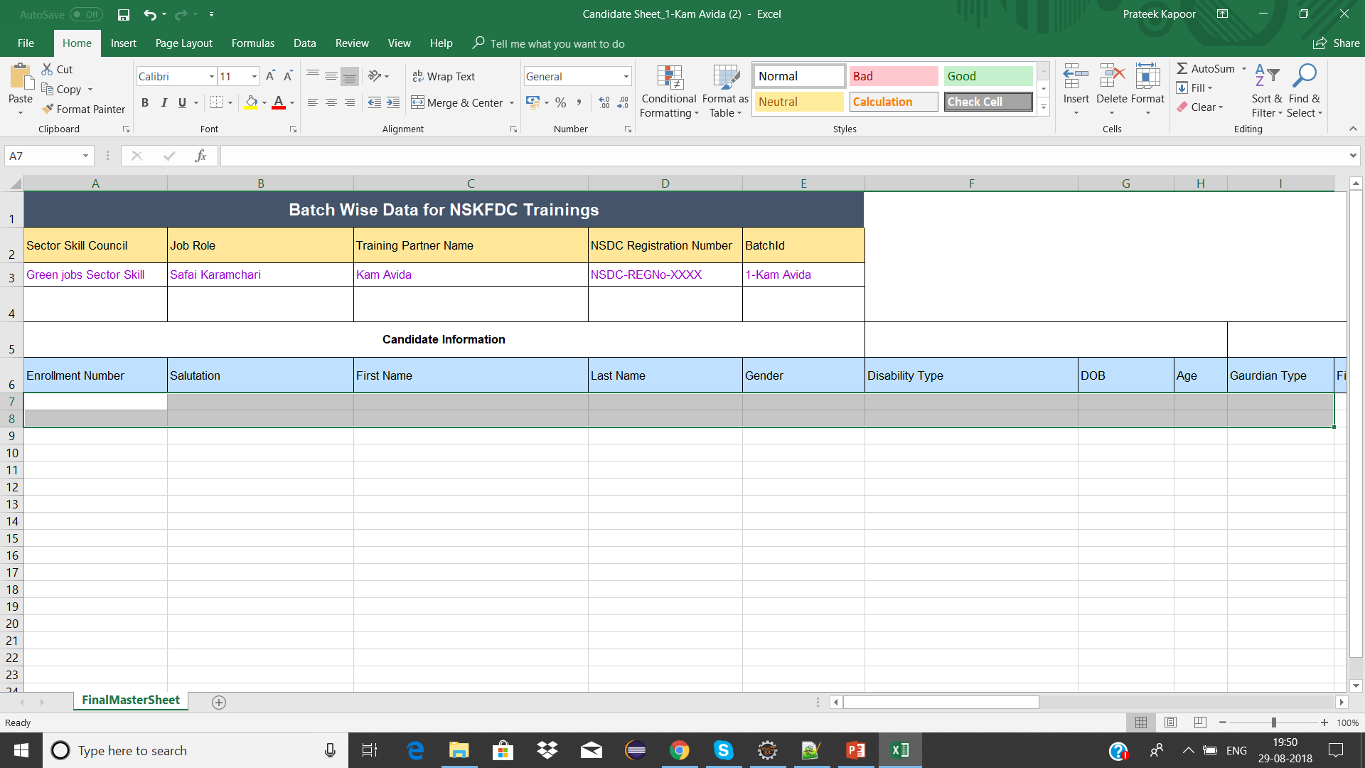
Columns not to be edited/updated or changed
1. Some columns in the excel sheet are pre-filled and are used by the system for different purpose. Any addition/change in those columns will result in the inconsistency and user will not be able to upload the sheet into the system.
Note : The user is advised not to change/edit the name of the columns and the information present inside these columns. If the information is edited then the system will not accept the excel sheet
*System will not accept the file if the Batch – ID in the sheet does not match the Batch – ID chosen while uploading the sheet
2. The Candidate/Guardian information in the excel sheet should be filled from row number 7
Note: The candidate/guardian information should be entered by the training partner from row number 7. No row should be left blank while entering the information.
Note: No row should be deleted/edited before row number 7, not even the name of headers should be changed by the training partner
3. The information that is mandatory in the excel sheet
Mandatory Fields in the Excel Sheet
Enrolment Number
First Name
Gender
DOB
First Name of Father/husband
Aadhar Number
Residential Address
Workplace Address

Slide 9
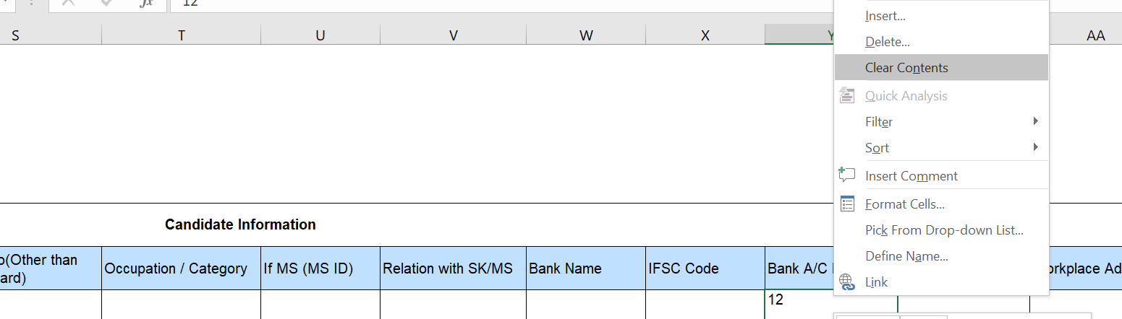
Rules for Filling the Excel Sheet
1. The format for enrolment number of the candidate in the excel sheet will have the following format : Batch – ID / Candidate Number
Example : KA_1234_Assam MC_1 / 1
Note: For each batch, this naming convention should be followed. Else, the system won’t get to know which candidate belongs to which batch and may not accept the sheet
2. Once the user has added the data into the system, they have to add margin to the entire cells and columns in the sheet till where the data is entered in the excel sheet.
Note: if the sheet does not have margins till where the data is entered, then the sheet will not be read by the system. Leading to inconsistency in data.
3. Set the format of date of birth column to Date (dd-mm-yy), if not done then the system will throw an error stating that the column is not set to date format and the data will not be submitted into the sheet
4. The age of the candidates in the batch should not be less than 18 otherwise, the system will not accept the record of that candidate
Deleting value from the excel sheet
If you wish to delete a value from an excel sheet, follow the given steps :
1. Choose the cell whose value has to be deleted and right click on the cell
2. Once you have right clicked on the cell. Click on clear contents option and your value will be deleted

Slide 10
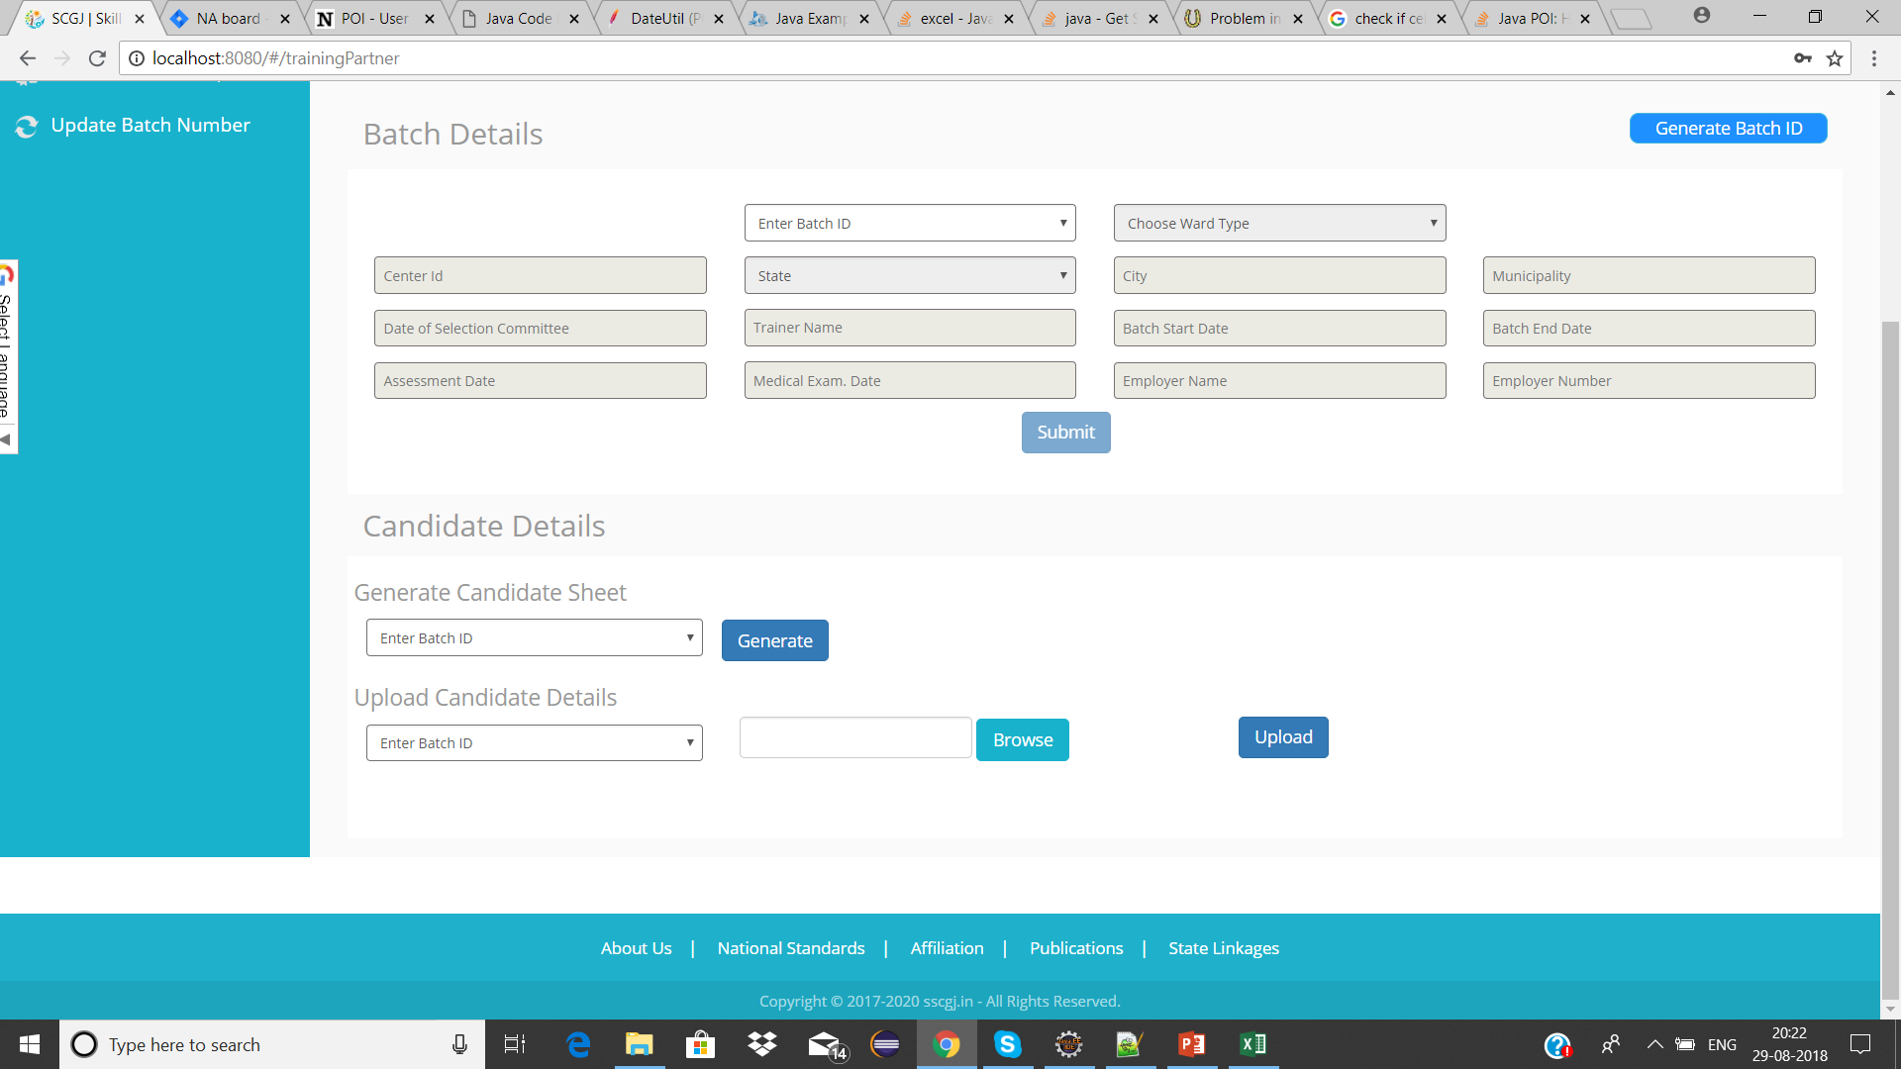
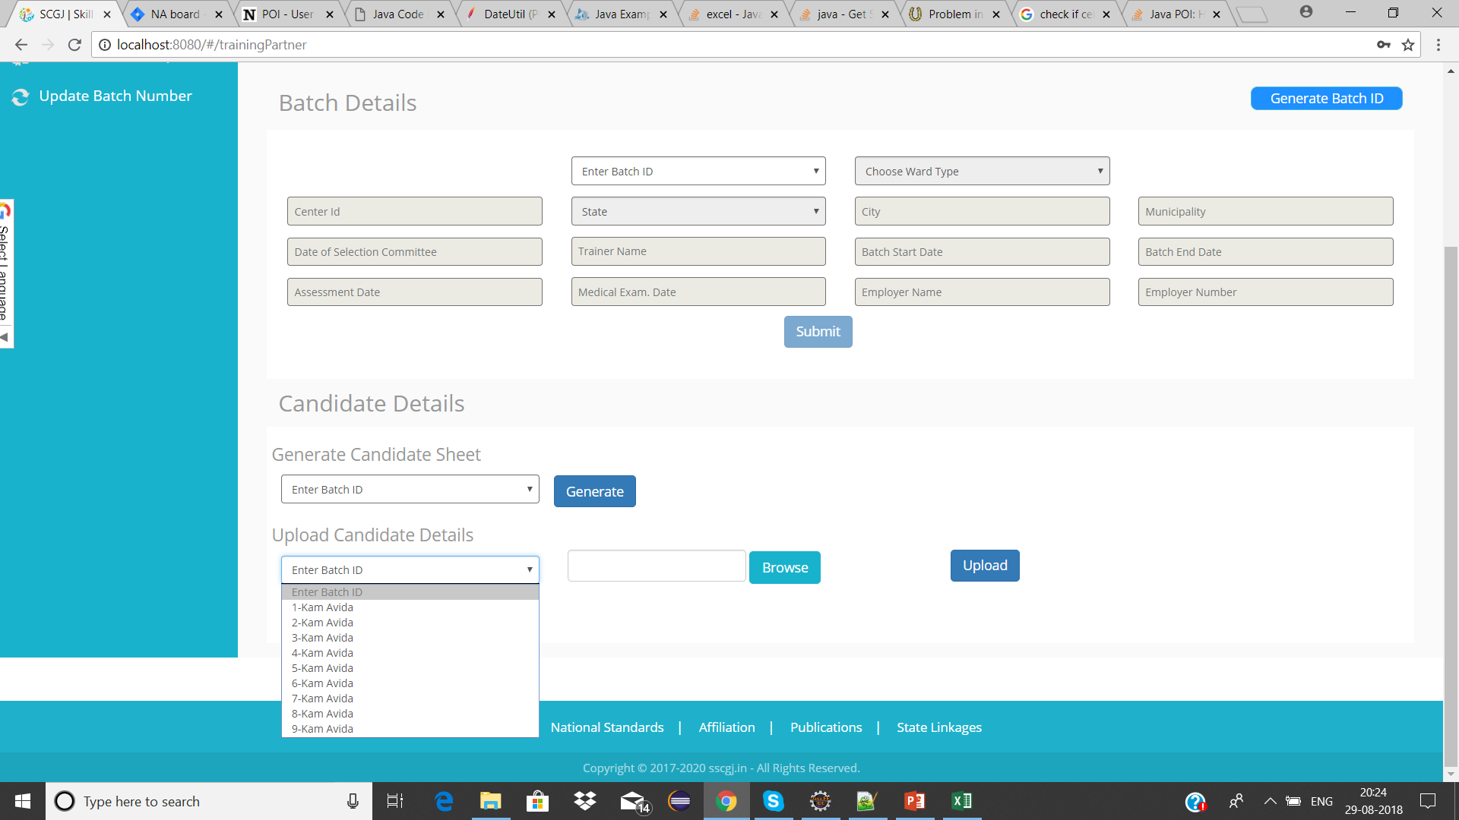
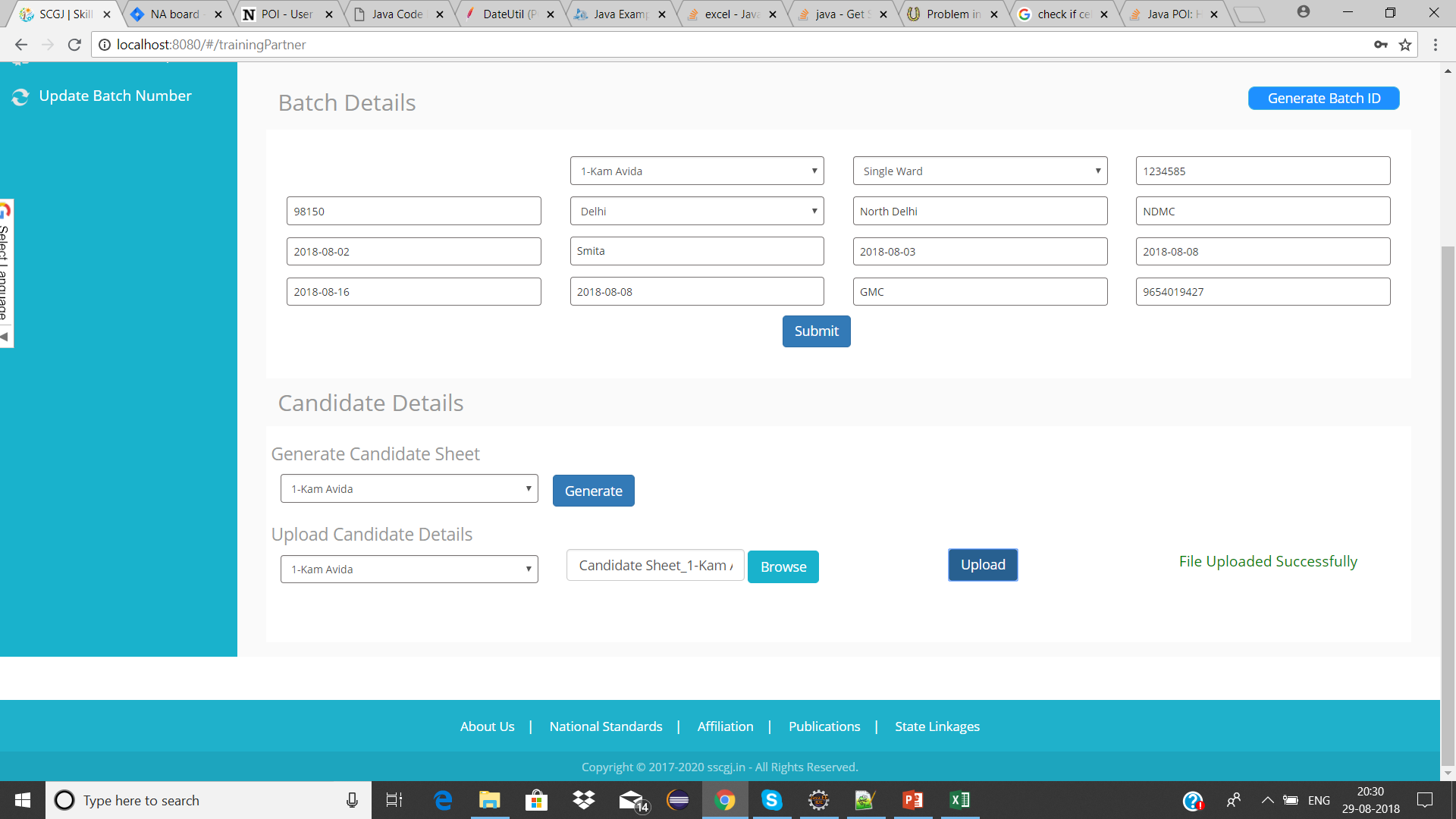
Uploading the excel sheet for candidate
To upload the candidate sheet into the system, follow the given steps
1. Navigate to Upload Candidate Sheet on the data import page
2. Select the Batch – ID for which the sheet needs to be uploaded & click on browse button
3. Select the Image by clicking on the browse button & click on the Upload Button
Note : if the sheet is successfully generated then a success message saying “File Uploaded Successfully” will be generated

Slide 11
Some Common Errors & Possible Solutions
Here is the list of some common errors that might occur while uploading the candidate sheet for a particular Batch – ID. This list contains some of the possible solutions to these errors
Error | Possible Solution
Batch Id in sheet does not match the Batch Id selected | Check the Batch Id in sheet and the Batch – Id selected from the drop down
Enrolment Number cannot be empty | Check if the enrolment number of all the candidates are entered
Salutation cannot be empty | Check if the Salutation of all the candidates are entered
Change the format of date of birth to (dd-mm-yyyy) | Check if the format of DOB cell is date type(dd-mm-yyyy)
Aadhar Number cannot be less than 12 digits | Check if the number of digits in aadhar card number is less than 12
Aadhar Number cannot be more than 12 digits | Check if the number of digits in aadhar card number is more than 12 digits
Duplicate Entry found for Aadhar Number/Mobile Number | Check if there are any candidates whose mobile/aadhar number are the same
Age cannot be less than 18 years | Check if any candidate is there whose age is less than 18 as per the DOB
Gender cannot be empty | Check if the Gender of the candidate is not empty
Date of Birth cannot be empty | Check if all the candidates have their date of birth in the sheet
Residential Address cannot be empty | Check if the residential address the candidate is not empty
Workplace address cannot be empty | Check if the workplace address is filled for every candidate
Cannot accept numeric value in cell “abc” | The cell “abc” cannot have numeric value
First Name cannot be empty | Check if the first name of the candidate is not empty

